Slide 1

Chapter 7
Internet Protocol Version4
(IPv4)
TCP/IP Protocol Suite
Copyright © The McGraw-Hill Companies, Inc. Permission required for reproduction or display.

Slide 2
7-1 INTRODUCTION
The Internet Protocol (IP) is the transmission mechanism used by the TCP/IP protocols at the network layer.
TCP/IP Protocol Suite

Slide 3
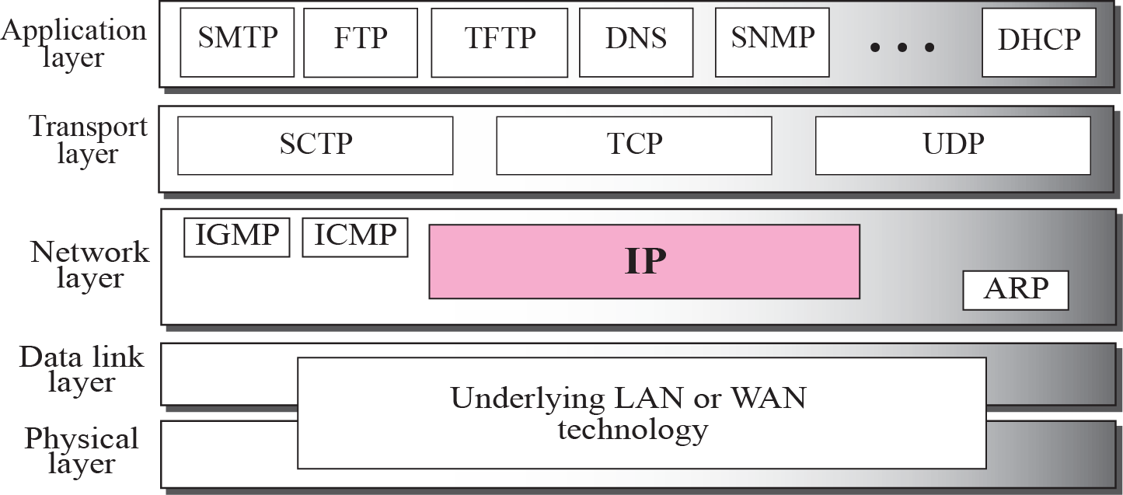
Figure 7.1 Position of IP in TCP/IP protocol suite
TCP/IP Protocol Suite

Slide 4
7-2 DATAGRAMS
Packets in the network (internet) layer are called datagrams. A datagram is a variable-length packet consisting of two parts: header and data. The header is 20 to 60 bytes in length and contains information essential to routing and delivery. It is customary in TCP/IP to show the header in 4-byte sections. A brief description of each field is in order.
TCP/IP Protocol Suite

Slide 5
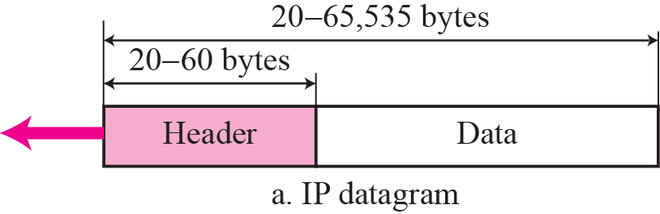
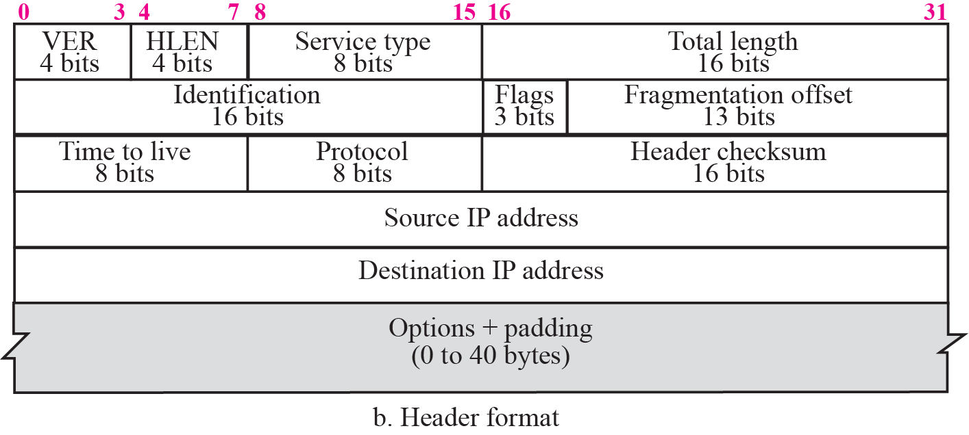
Figure 7.2 IP datagram
TCP/IP Protocol Suite

Slide 6
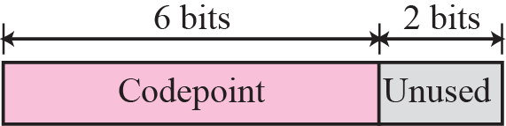
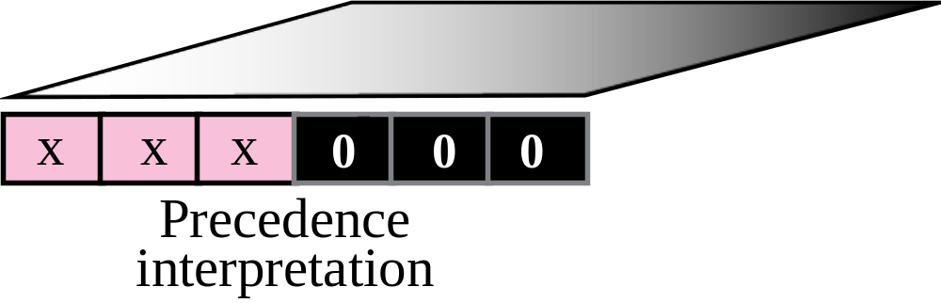
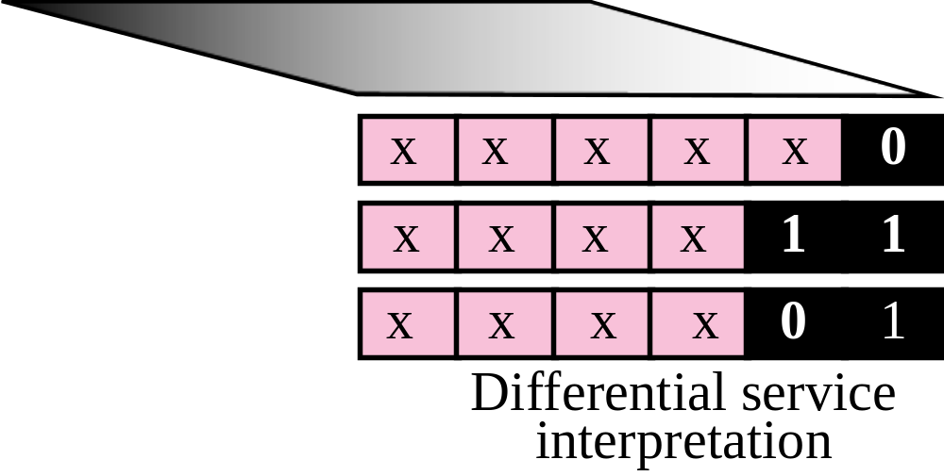
Figure 7.3 Service type
TCP/IP Protocol Suite

Slide 7
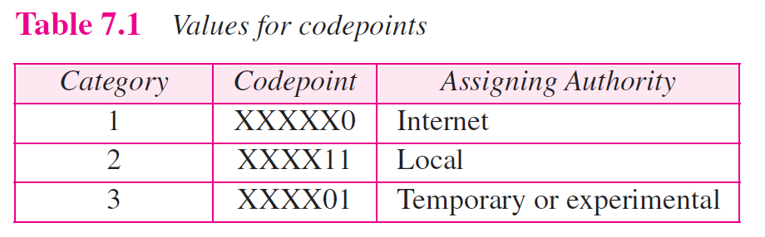
TCP/IP Protocol Suite

Slide 8

Note
The total length field defines the total length of the datagram including the header.
TCP/IP Protocol Suite

Slide 9

Figure 7.4 Encapsulation of a small datagram in an Ethernet frame
TCP/IP Protocol Suite

Slide 10
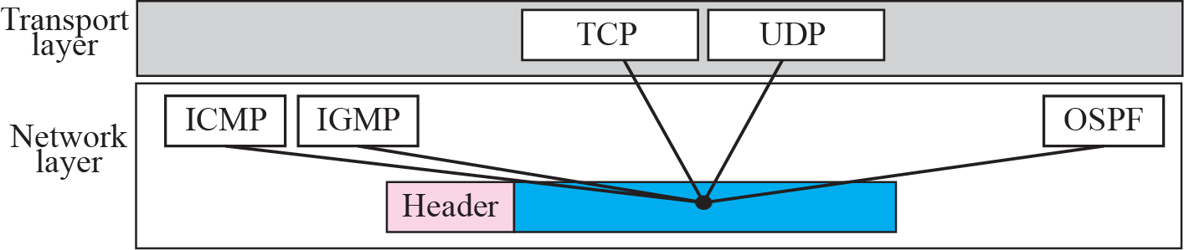
Figure 7.5 Multiplexing
TCP/IP Protocol Suite

Slide 11
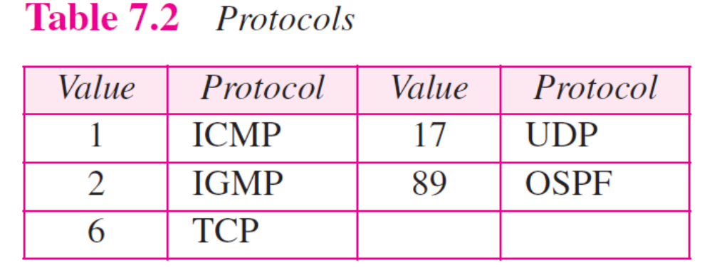
TCP/IP Protocol Suite

Slide 12
7-3 FRAGMENTATION
A datagram can travel through different networks. Each router decapsulates the IP datagram from the frame it receives, processes it, and then encapsulates it in another frame. The format and size of the received frame depend on the protocol used by the physical network through which the frame has just traveled. The format and size of the sent frame depend on the protocol used by the physical network through which the frame is going to travel.
TCP/IP Protocol Suite

Slide 13

Figure 7.6 MTU
TCP/IP Protocol Suite

Slide 14
Note
Only data in a datagram is fragmented.
TCP/IP Protocol Suite

Slide 15

Figure 7.7 Flags field
TCP/IP Protocol Suite

Slide 16
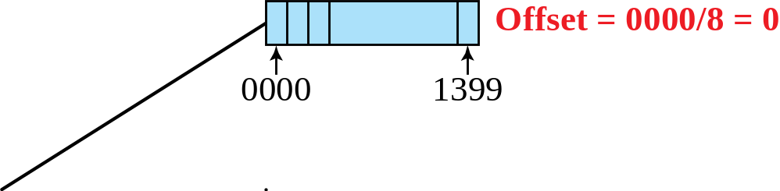
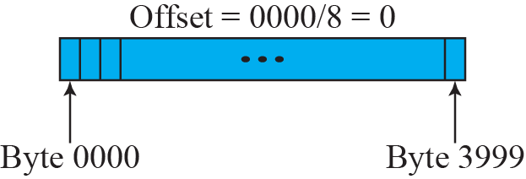
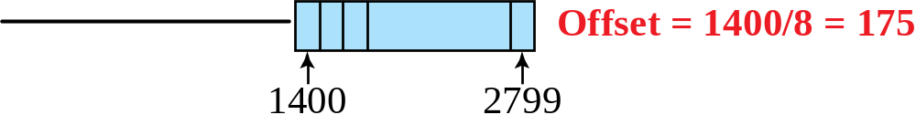
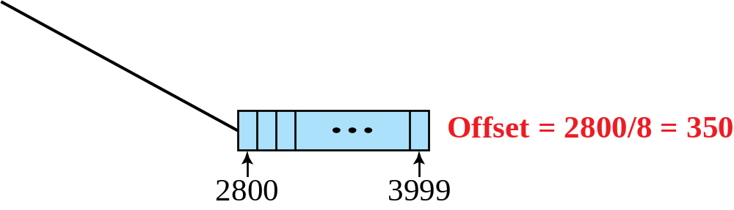
Figure 7.8 Fragmentation example
TCP/IP Protocol Suite

Slide 17
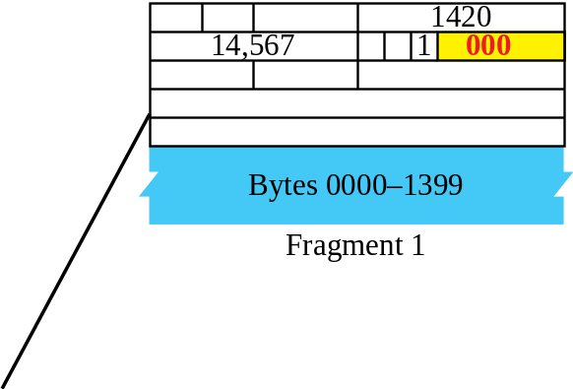
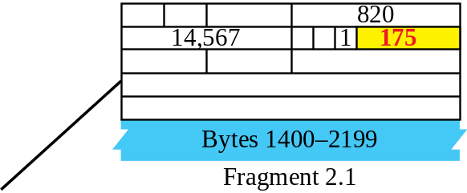
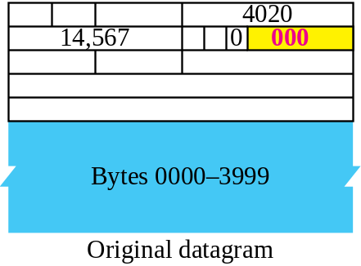
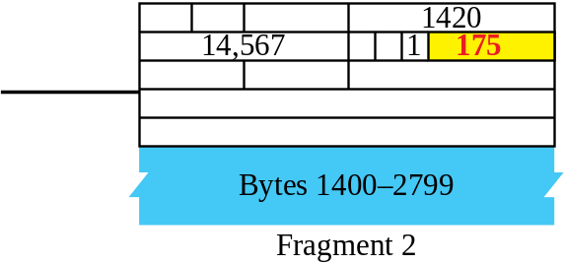
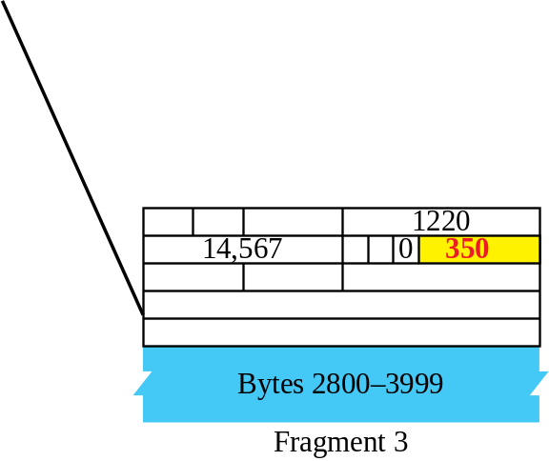
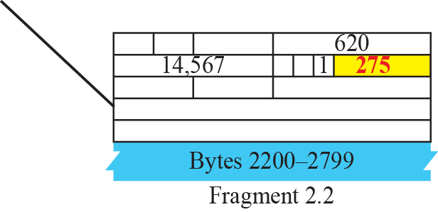
Figure 7.9 Detailed fragmentation example
TCP/IP Protocol Suite

Slide 18
7-4 OPTIONS
The header of the IP datagram is made of two parts: a fixed part and a variable part. The fixed part is 20 bytes long and was discussed in the previous section. The variable part comprises the options, which can be a maximum of 40 bytes.
Options, as the name implies, are not required for a datagram. They can be used for network testing and debugging. Although options are not a required part of the IP header, option processing is required of the IP software.
TCP/IP Protocol Suite

Slide 19
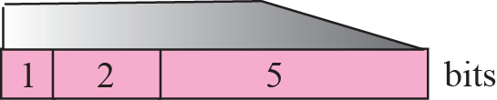
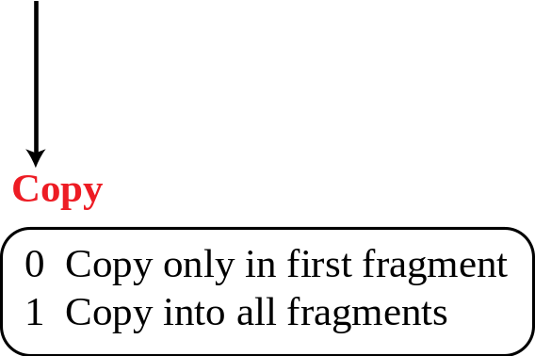
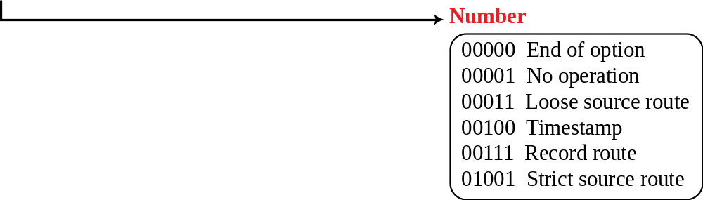
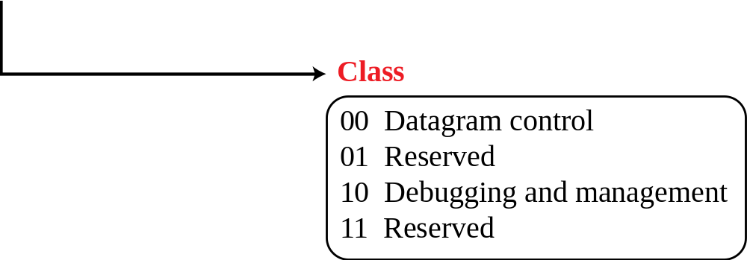
Figure 7.10 Option format
TCP/IP Protocol Suite

Slide 20
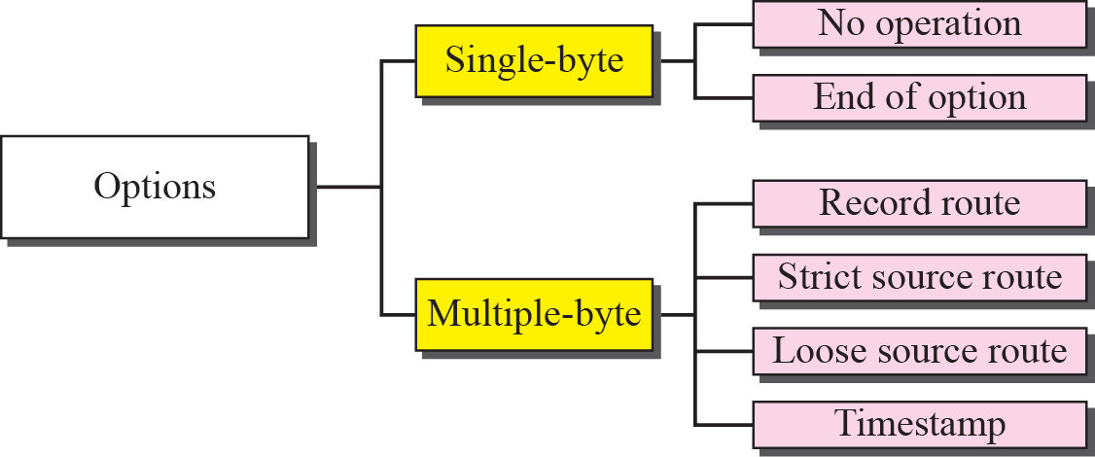
Figure 7.11 Categories of options
TCP/IP Protocol Suite

Slide 21
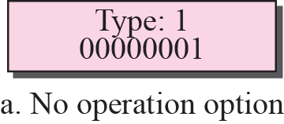
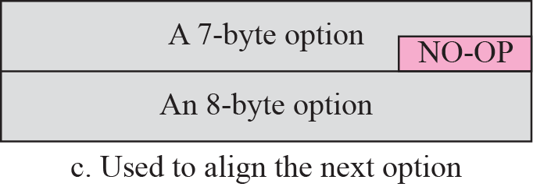
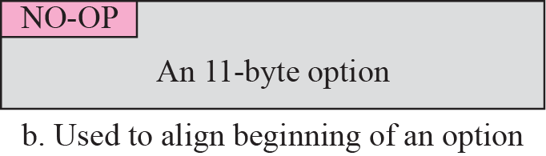
Figure 7.12 No operation option
TCP/IP Protocol Suite

Slide 22
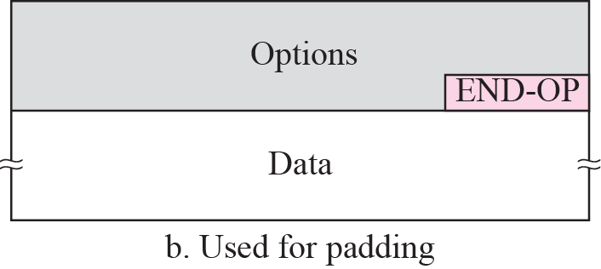
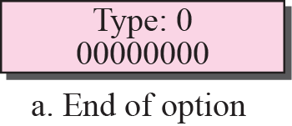
Figure 7.13 Endo-of-option option
TCP/IP Protocol Suite

Slide 23
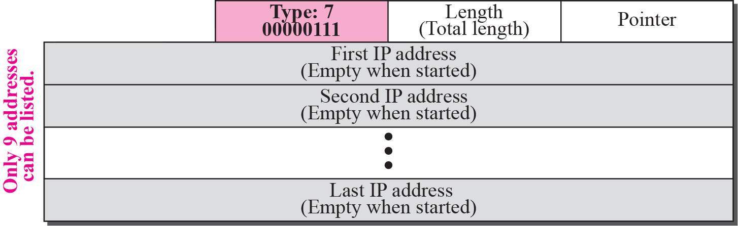
Figure 7.14 Record-route option
TCP/IP Protocol Suite

Slide 24
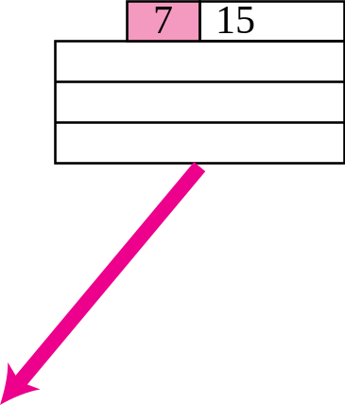
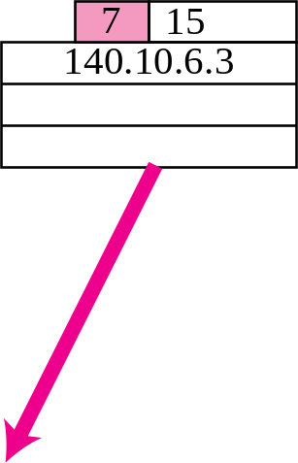
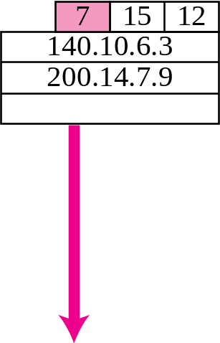
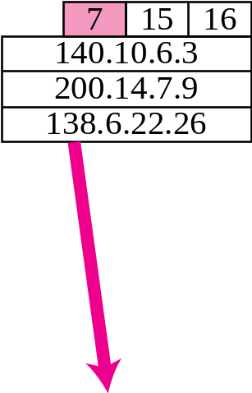
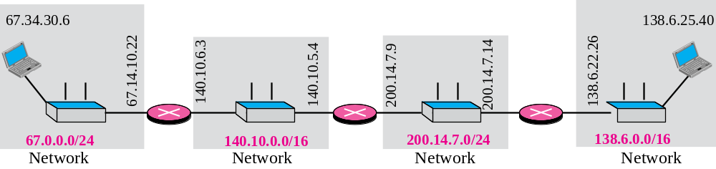
Figure 7.15 Record-route concept
4
8
TCP/IP Protocol Suite

Slide 25
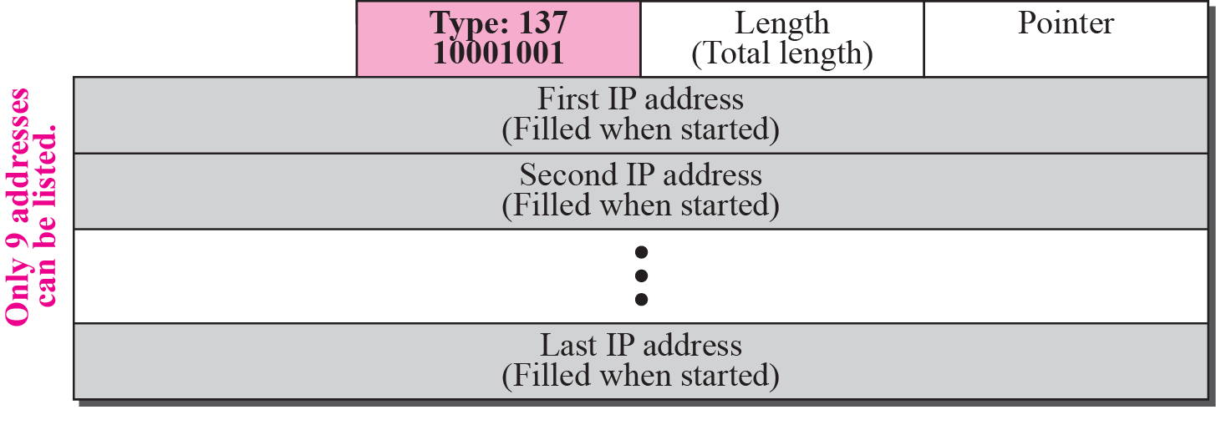
Figure 7.16 Strict-source-route option
TCP/IP Protocol Suite

Slide 26
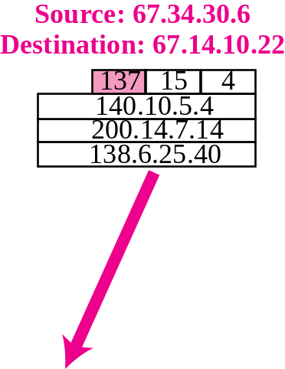
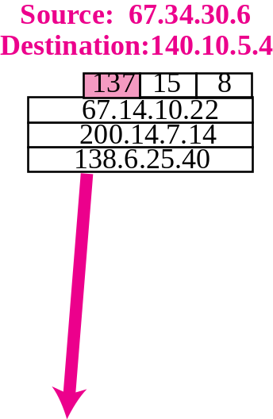
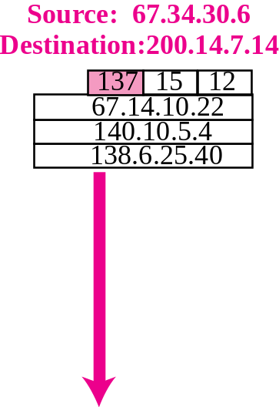
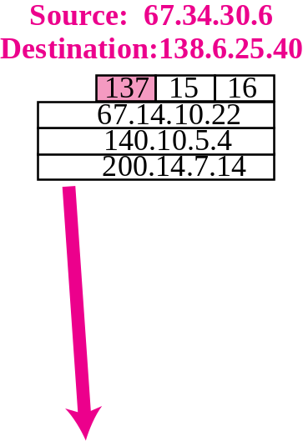
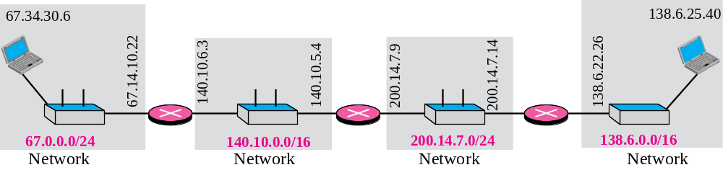
Figure 7.17 Strict-source-route option
TCP/IP Protocol Suite

Slide 27
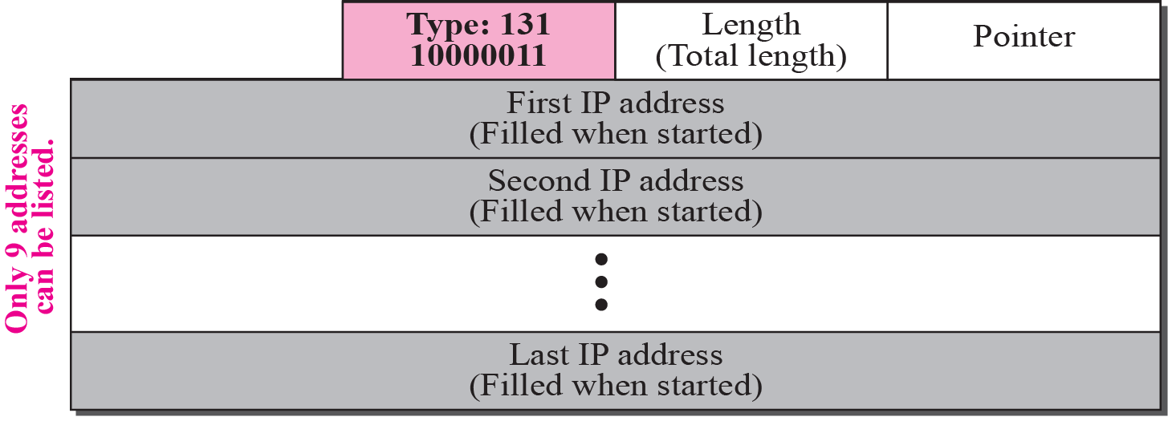
Figure 7.18 Loose-source-route option
TCP/IP Protocol Suite

Slide 28
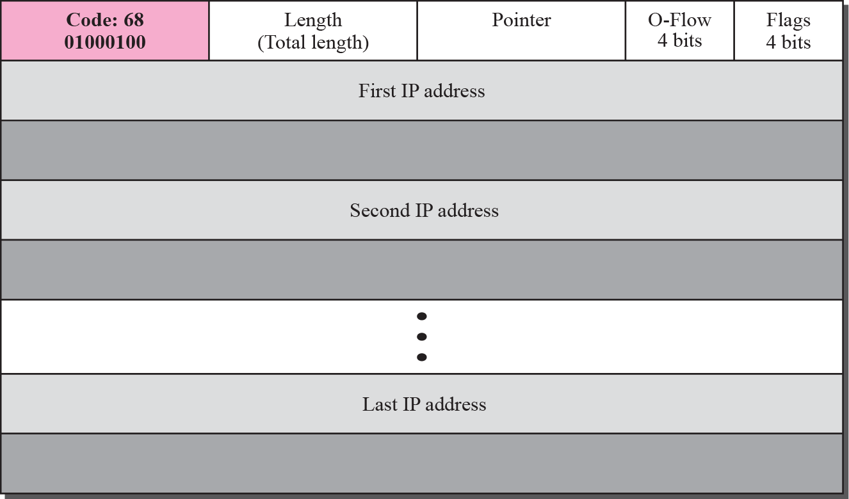
Figure 7.19 Time-stamp option
TCP/IP Protocol Suite

Slide 29
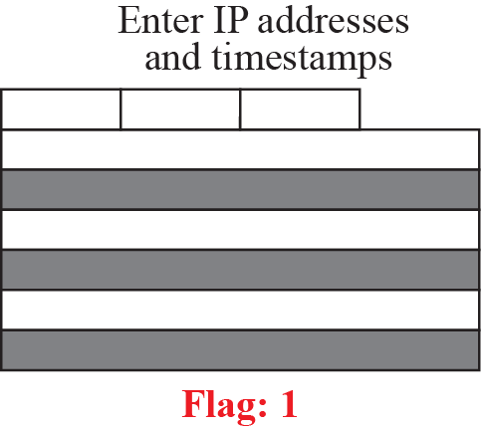
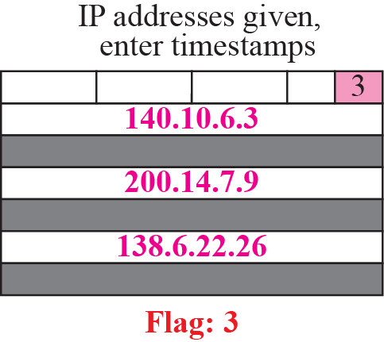
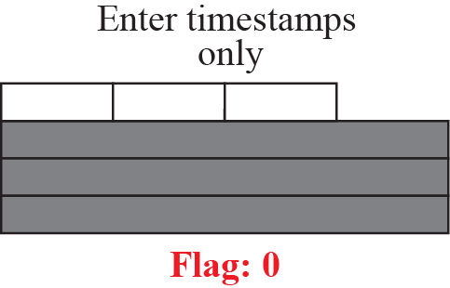
Figure 7.20 Use of flags in timestamp
TCP/IP Protocol Suite

Slide 30
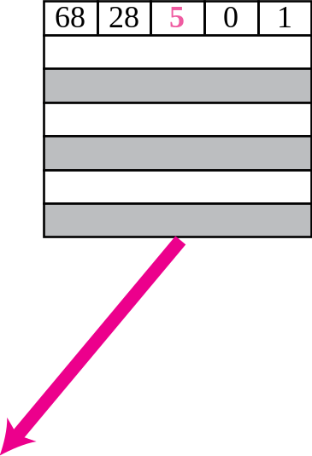
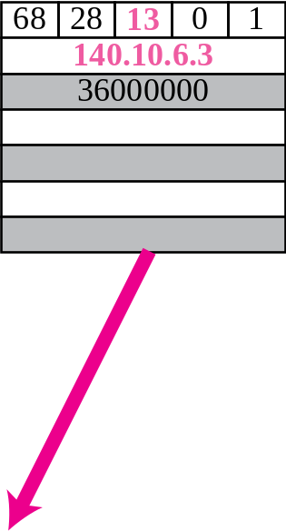
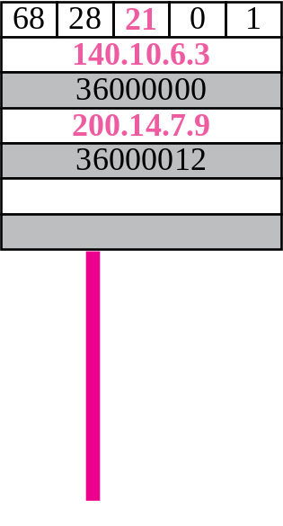
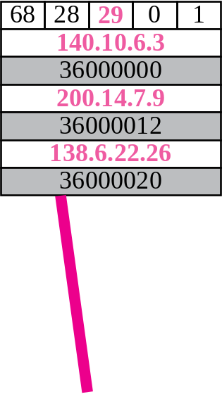

Figure 7.21 Timestamp concept
TCP/IP Protocol Suite

Slide 31
Example 7.10
Which of the six options must be copied to each fragment?
Solution
We look at the first (left-most) bit of the type for each option.
a. No operation: type is 00000001; not copied.
b. End of option: type is 00000000; not copied.
c. Record route: type is 00000111; not copied.
d. Strict source route: type is 10001001; copied.
e. Loose source route: type is 10000011; copied.
f. Timestamp: type is 01000100; not copied.
TCP/IP Protocol Suite

Slide 32
Example 7.11
Which of the six options are used for datagram control and which
for debugging and managements?
Solution
We look at the second and third (left-most) bits of the type.
a. No operation: type is 00000001; datagram control.
b. End of option: type is 00000000; datagram control.
c. Record route: type is 00000111; datagram control.
d. Strict source route: type is 10001001; datagram control.
e. Loose source route: type is 10000011; datagram control.
f. Timestamp: type is 01000100; debugging and management
control.
TCP/IP Protocol Suite

Slide 33

Example 7.12
One of the utilities available in UNIX to check the traveling of the IP packets is ping. In the next chapter, we talk about the ping program in more detail. In this example, we want to show how to use the program to see if a host is available. We ping a server at De Anza College named fhda.edu. The result shows that the IP address of the host is 153.18.8.1. The result also shows the number of bytes used.
TCP/IP Protocol Suite

Slide 34

Example 7.13
We can also use the ping utility with the -R option to implement the record route option. The result shows the interfaces and IP addresses.
TCP/IP Protocol Suite

Slide 35

Example 7.14
The traceroute utility can also be used to keep track of the route of a packet. The result shows the three routers visited.
TCP/IP Protocol Suite

Slide 36

Example 7.15
The traceroute program can be used to implement loose source routing. The -g option allows us to define the routers to be visited, from the source to destination. The following shows how we can send a packet to the fhda.edu server with the requirement that the packet visit the router 153.18.251.4.
TCP/IP Protocol Suite

Slide 37

Example 7.16
The traceroute program can also be used to implement strict source routing. The -G option forces the packet to visit the routers defined in the command line. The following shows how we can send a packet to the fhda.edu server and force the packet to visit only the router 153.18.251.4.
TCP/IP Protocol Suite

Slide 38
7-5 CHECKSUM
The error detection method used by most TCP/IP protocols is called the checksum. The checksum protects against the corruption that may occur during the transmission of a packet. It is redundant information added to the packet. The checksum is calculated at the sender and the value obtained is sent with the packet. The receiver repeats the same calculation on the whole packet including the checksum. If the result is satisfactory (see below), the packet is accepted; otherwise, it is rejected.
TCP/IP Protocol Suite

Slide 39
Topics Discussed in the Section
Checksum Calculation at the Sender
Checksum Calculation at the Receiver
Checksum in the Packet
TCP/IP Protocol Suite

Slide 40




Figure 7.22 Checksum concept
TCP/IP Protocol Suite

Slide 41



Figure 7.23 Checksum in one’s complement arithmetic
TCP/IP Protocol Suite

Slide 42
Note
Checksum in IP covers only the header, not the data.
TCP/IP Protocol Suite

Slide 43
Example 7.17
Figure 7.24 shows an example of a checksum calculation at the sender site for an IP header without options. The header is divided into 16-bit sections. All the sections are added and the sum is complemented. The result is inserted in the checksum field.
TCP/IP Protocol Suite

Slide 44


Figure 7.24 Example of checksum calculation at the sender
TCP/IP Protocol Suite
Notes:
Substitute for 012.6.7.917015010.12.14.50028Substitute for 012.6.7.917015010.12.14.50028Substitute for 0Substitute for 0

Slide 45
Example 7.18
Figure 7.25 shows the checking of checksum calculation at the receiver site (or intermediate router) assuming that no errors occurred in the header. The header is divided into 16-bit sections. All the sections are added and the sum is complemented. Since the result is 16 0s, the packet is accepted.
TCP/IP Protocol Suite

Slide 46


Figure 7.25 Example of checksum calculation at the receiver
TCP/IP Protocol Suite

Slide 47
Note
Appendix D gives an algorithm for checksum calculation.
TCP/IP Protocol Suite

Slide 48
7-6 IP OVER ATM
In the previous sections, we assumed that the underlying networks over which the IP datagrams are moving are either LANs or point-to-point WANs. In this section, we want to see how an IP datagram is moving through a switched WAN such as an ATM. We will see that there are similarities as well as differences. The IP packet is encapsulated in cells (not just one). An ATM network has its own definition for the physical address of a device. Binding between an IP address and a physical address is attained through a protocol called ATMARP.
TCP/IP Protocol Suite

Slide 49
Topics Discussed in the Section
ATM WANs
Routing the Cells
TCP/IP Protocol Suite

Slide 50

Figure 7.26 An ATM WAN in the Internet
TCP/IP Protocol Suite

Slide 51
Note
The AAL layer used by the IP protocol is AAL5.
TCP/IP Protocol Suite

Slide 52



Figure 7.27 Entering-point and exiting-point routers
TCP/IP Protocol Suite

Slide 53





Figure 7.28 Address binding in IP over ATM
TCP/IP Protocol Suite

Slide 54
7-7 SECURITY
The IPv4 protocol, as well as the whole Internet, was started when the Internet users trusted each other. No security was provided for the IPv4 protocol. Today, however, the situation is different; the Internet is not secure any more. Although we discuss network security in general and IP security in particular in Chapters 29 and 30, we give a brief idea about the security issues in IP protocol and the solution.
TCP/IP Protocol Suite

Slide 55
Topics Discussed in the Section
Security Issues
IPSec
TCP/IP Protocol Suite

Slide 56
7-8 IP PACKAGE
In this section, we present a simplified example of a hypothetical IP package. Our purpose is to show the relationships between the different concepts discussed in this chapter.
TCP/IP Protocol Suite

Slide 57
Topics Discussed in the Section
Header-Adding Module
Processing Module
Queues
Routing Table
Forwarding Module
MTU Table
Fragmentation Module
Reassembly Table
Reassembly Module
TCP/IP Protocol Suite

Slide 58

Figure 7.29 IP components
TCP/IP Protocol Suite

Slide 59

TCP/IP Protocol Suite

Slide 60

TCP/IP Protocol Suite

Slide 61

TCP/IP Protocol Suite

Slide 62

TCP/IP Protocol Suite

Slide 63

Figure 7.30 Reassembly table
TCP/IP Protocol Suite

Slide 64
TCP/IP Protocol Suite

